Slide 1

Unsupervised Scene Categorization with RGB-D data
Nick Hageman and Nathan Schaefer
March 30, 2024

Slide 2
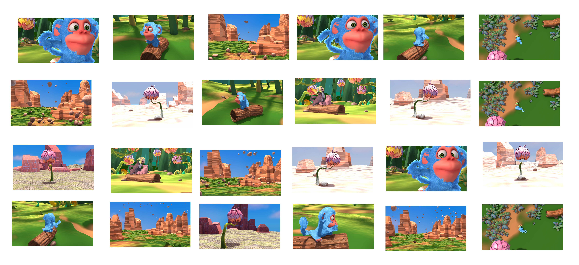
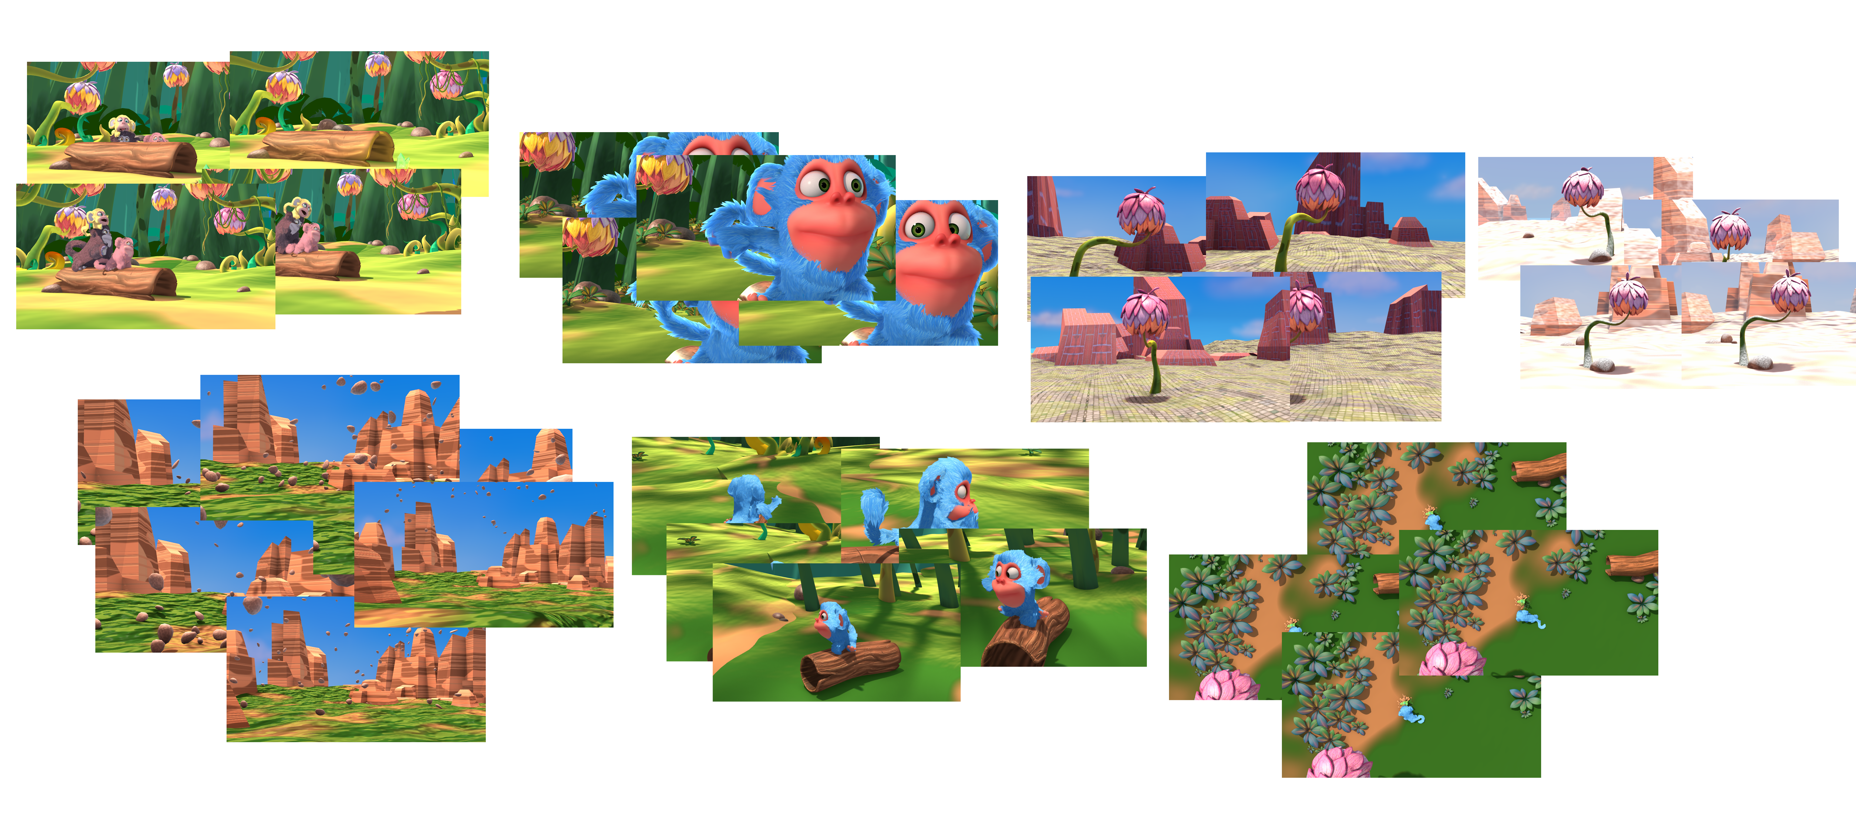
Overview
We wanted to be able to cluster scenes captured from a short film using RGB-D data with no prior knowledge of labels.
By combining both RGB and depth information, we intend to enhance scene representation and understanding, particularly focusing on spatial relationships and object geometries.
Clustering scenes by utilizing depth could be useful in systems that capture/utilize 3D data such as Augmented/Virtual Reality or Robotics & Navigation.
Notes:
NICK - So for our project, we wanted to be able to cluster scenes from a short film using RGB-D data and since it's unsupervised, we made sure not to include the labels from the scenes. The reason we are including the depth information for our clustering is because we thought it may enhance the scene representation in regards to spatial relationships and objects in the scene. There are many real world applications that utilize 3D data including AR/VR and robotics & navigation.

Slide 3
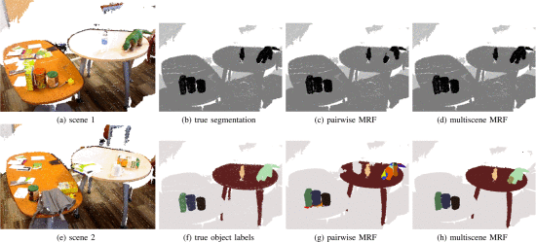
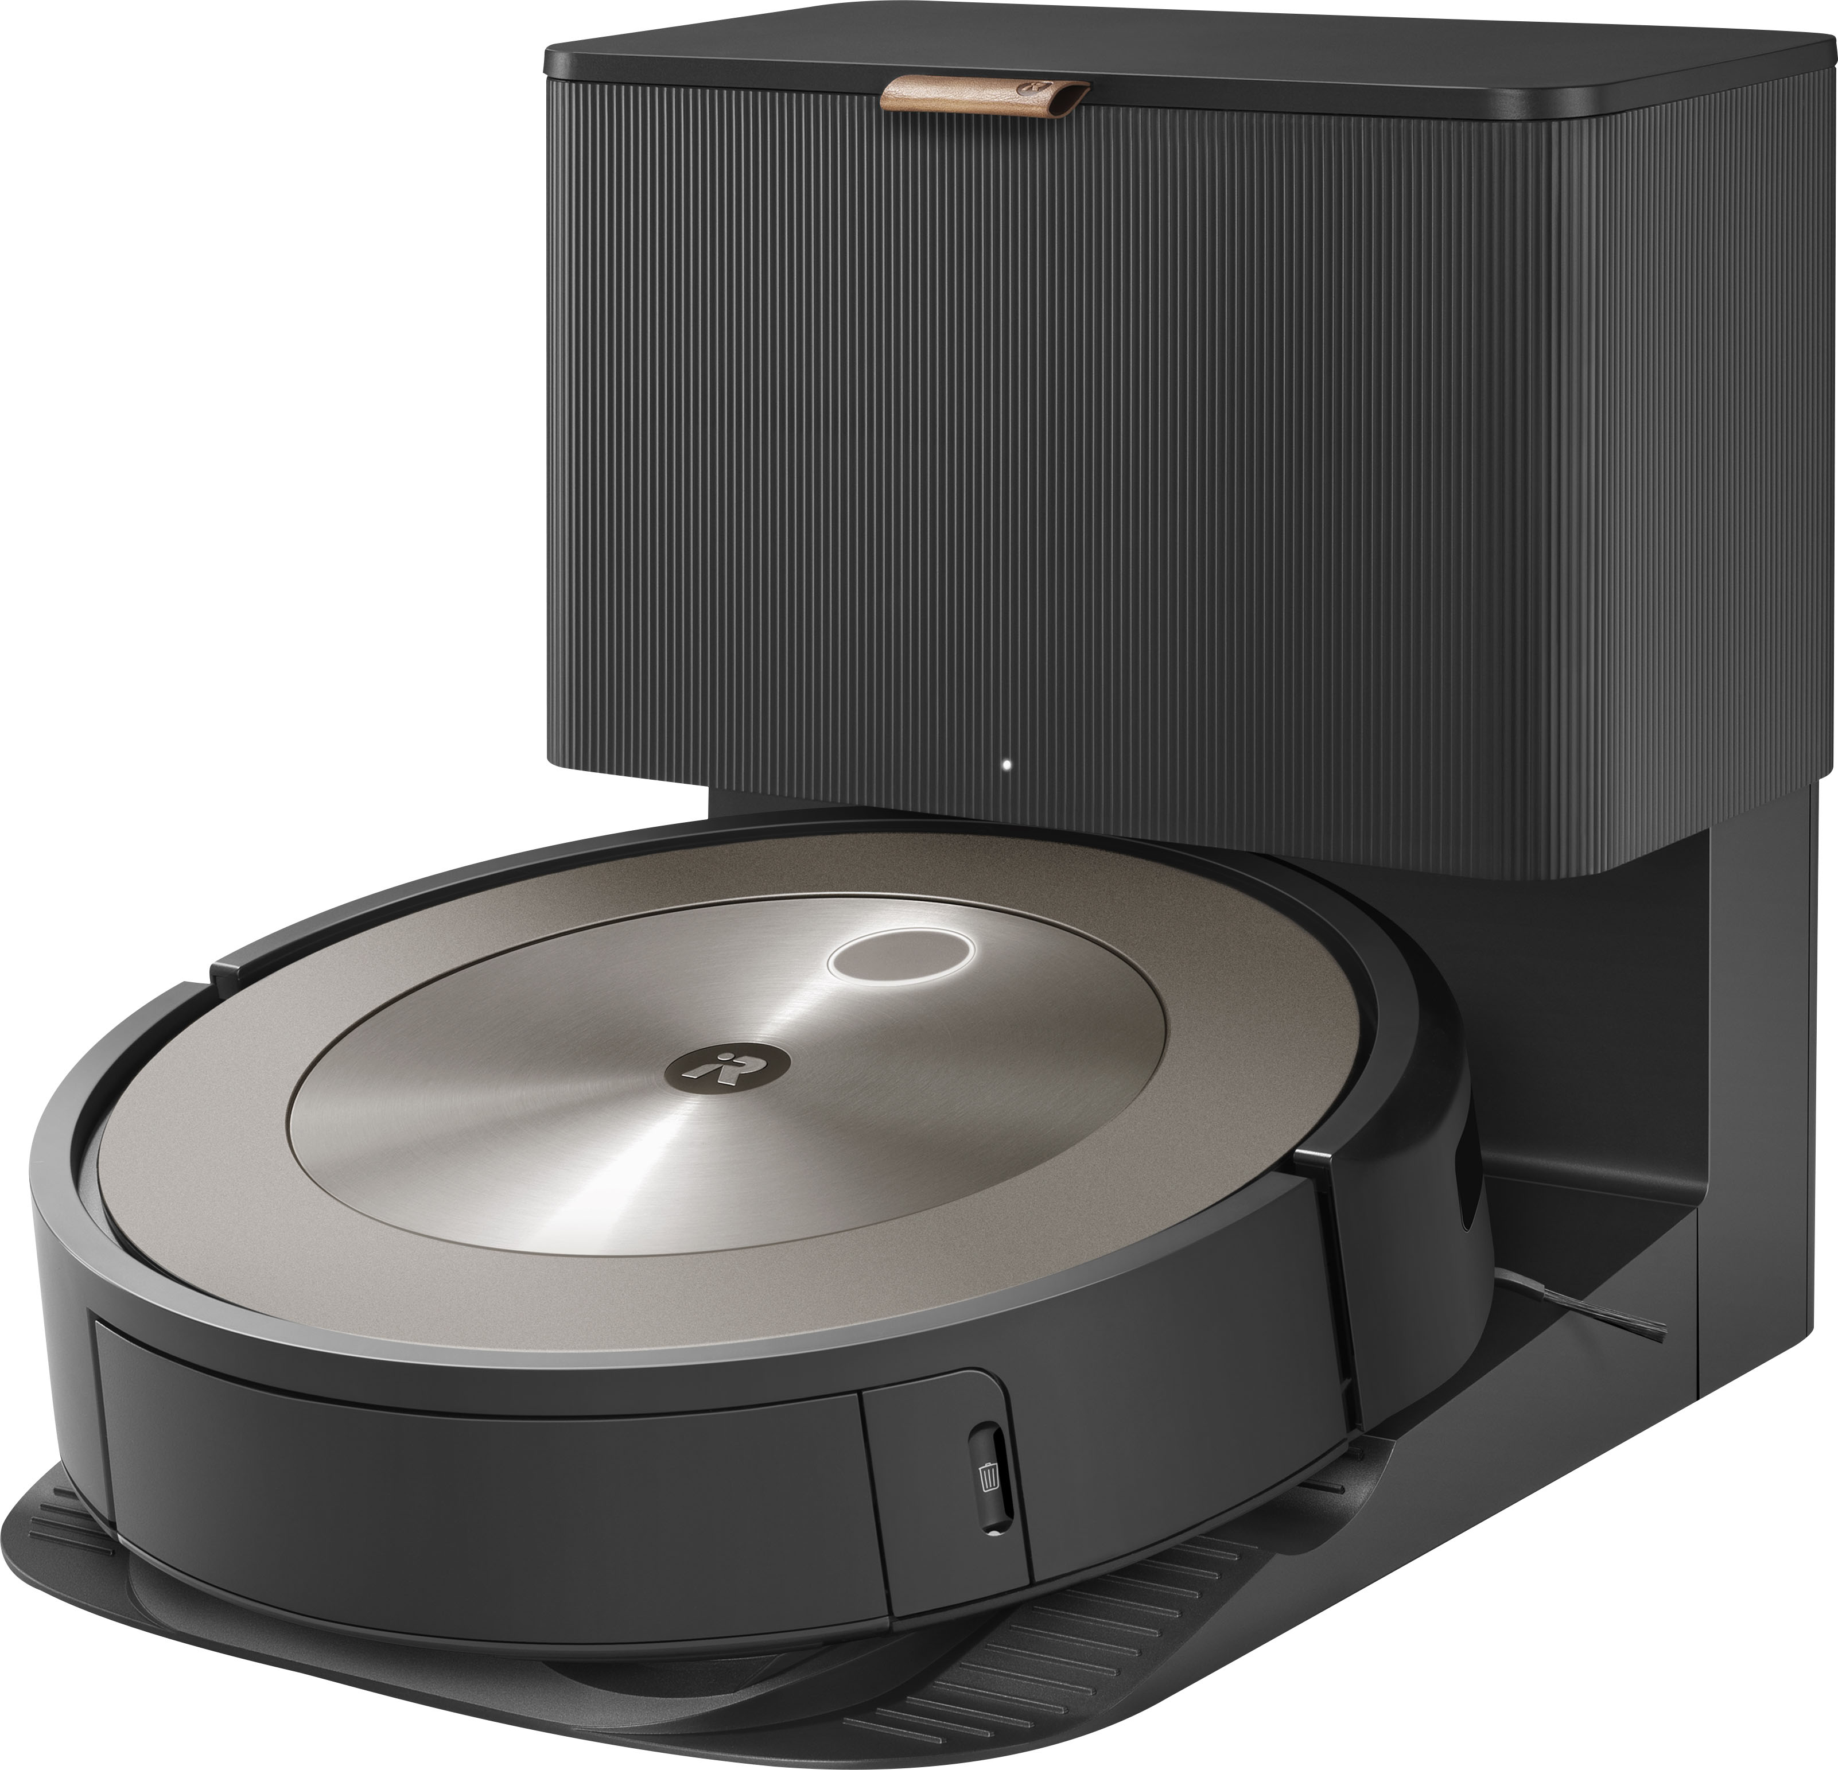
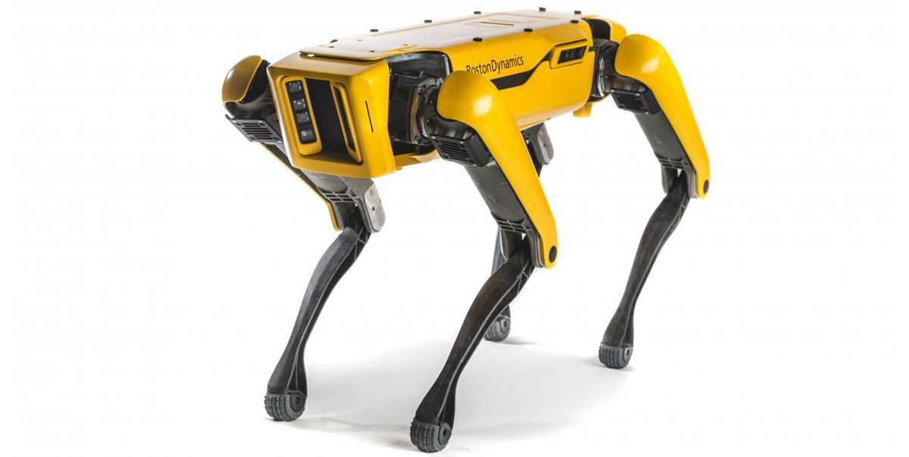
Background
Previous research in clustering RGB-D data has mainly focused on tasks such as 3D reconstruction and plane segmentation.
Additionally, related work has explored the use of RGB-D cameras for unsupervised object discovery and scene understanding.
The goal is to enable robots to learn about objects in an unsupervised manner by detecting changes in the environment over time.
Our project differs in focus from this work by concentrating specifically on scene categorization rather than object discovery and motion tracking.
Insights from these related works inform our understanding of the capabilities and challenges associated with processing RGB-D data for scene analysis.
Yurong You, Katie Luo, Cheng Perng Phoo "Learning to Detect Mobile Objects from LiDAR Scans Without Labels", 2022 IEEE/CVF Conference on Computer Vision and Pattern Recognition (CVPR), pp.1120-1130, 2022.​
Notes:
NATE - While we did find some related research involving 3D reconstruction and plane segmentation using RGB-D data, we couldn't exactly find research that COMPLETELY aligned with our project. So, the work we came across used RGB-D cameras for object discovery and scene understanding. The goal of one of these papers was to get robots to understand a 3D environment while detecting changes over time. Some insights from this research related with our project in terms of processing RGB-D data for scene analysis.

Slide 4
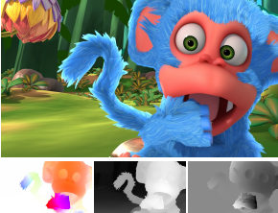
Approach
Unsupervised Clustering
Use an Auto-Encoder so we can later use it to extract key features from scenes
Once the key features have been extracted, perform K-Means clustering algorithm
Monkaa Dataset
~35,000 stereo frames with ground truth for disparity maps
Memory limitations allowed us to use about half of the scenes
Training & Evaluation
Shuffle weights when training, but extract features from data in-order so we can compare with ground truth data array we created (since # of scenes were known)
Saved weights depending on the lowest MSE loss each epoch
Used Adam optimizer for its adaptive learning rate
Notes:
NICK - So our approach to the problem was to first use an Auto Encoder to get our input images down into a latent space which would extract key features from that scene. After we've gathered those key features, we would then perform clustering on them for categorization using an sklearn implementation of a KMeans clustering algorithm. We ended up using the same dataset from our Phase 1 project since we were familiar with working with it and it provided a good structure in terms of separating the different scenes that we could later use for ground truth for evaluation. One big challenge we had for our project was running out of memory when extracting features using our model, we simply couldn't fit all the encoded images before killing the kernel. Since we need all the inputs to be in their latent space for clustering, we had to cut down the number of scenes to be able to cluster them which was a memory limitation. For training our model, the reason we shuffled data while training was so our model didn't pickup trends from the order of our scenes being input into our model. While training, we would save the weights if they had the lowest loss. We also used the Adam optimizer for it's adaptive learning rate. Another thing worth noting is that when we run all of our images through our model to extract features, we use a different data loader that doesn't shuffle the data. The reason we don't shuffle the data for the features is so after we perform the clustering, we can compare this array with a ground truth array which we can make since we know the number of frames in each scene and what order they are in.

Slide 5
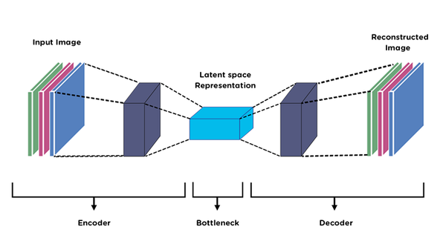
Approach
Constructing our Neural Network
The encoder consists of several convolutional layers designed to compress the input data into a smaller latent space representation.
This latent space is what we use for the clustering
Varied the size of the number of layers, encoding output, as well as different loss functions for hyperparameter tuning while training.
Notes:
NATE - For our Network, the encoder consisted of several 2D convolutions which compressed the image into a smaller latent space representation, which is what we used for clustering and we can get more into that when we walk through the code. Now while we were training the model, we varied the number of layers, loss functions, and encoding output to tune our hyperparameters.

Slide 6
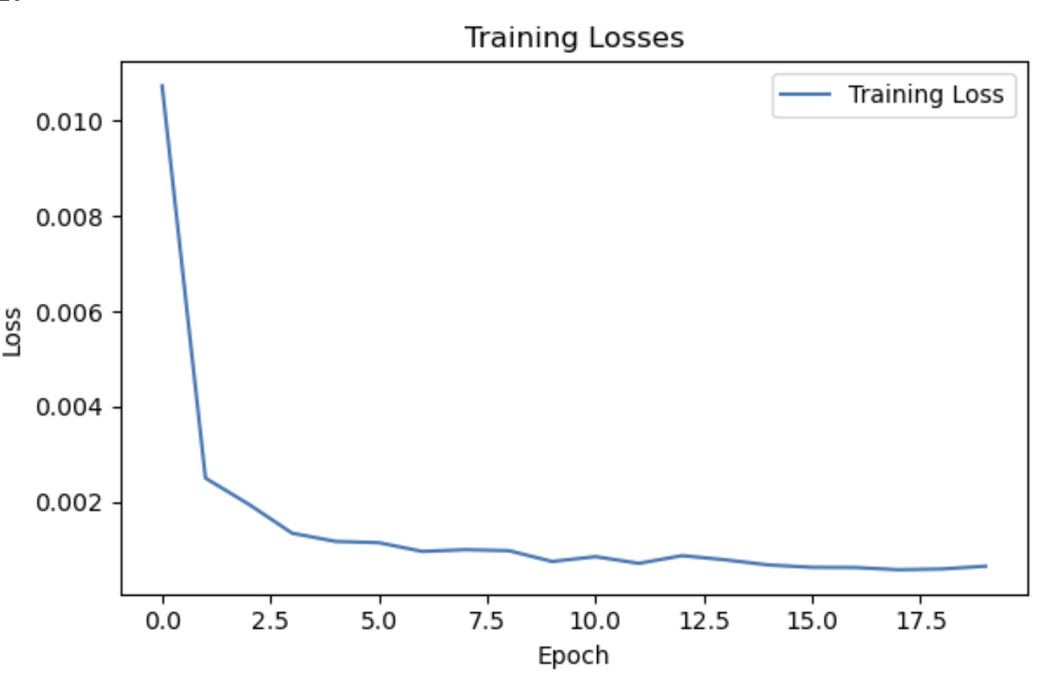
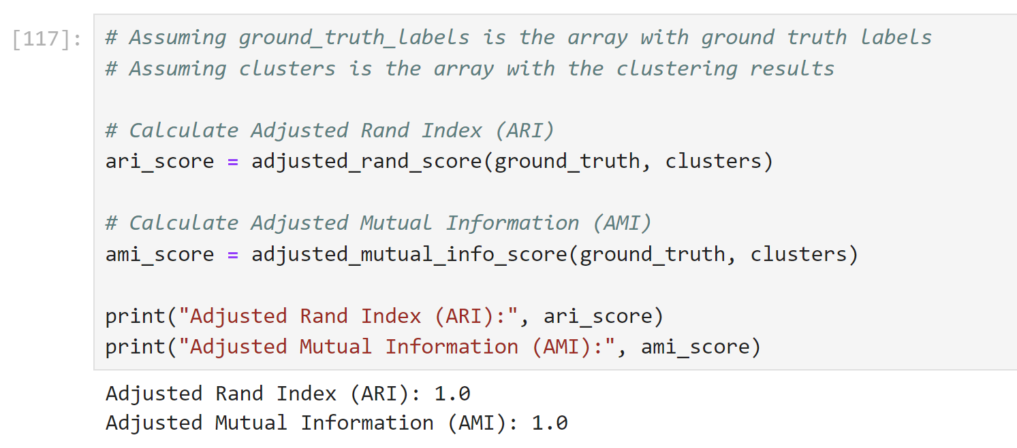
Results
Achieved 100% accuracy for clustering the data into their respective scenes without knowledge of any labels
Used ARI & AMI metrics to compare our cluster array with ground truth data
A score of 1 indicates perfect similarity
A score of 0 or negative indicates random or dissimilar clusterings
Notes:
NATE - In the end we were actually able to get 100% accuracy in classifying the images to their corresponding scenes without the use of any labels of the ground truth. We ended up using ARI and AMI metrics (which are pretty much similarity functions) to evaluate our clusters with the actual ground truth data which returns a score from negative One to One. Where a score of 1 means perfect similarity (which is what we got) and a 0 or negative means random or dissimilar clusterings. Now while we thought this may be too easy if we're getting 100% accuracy, we went ahead and tried it with JUST rgb data to see if our depth information was actually helping us in the clustering.

Slide 7
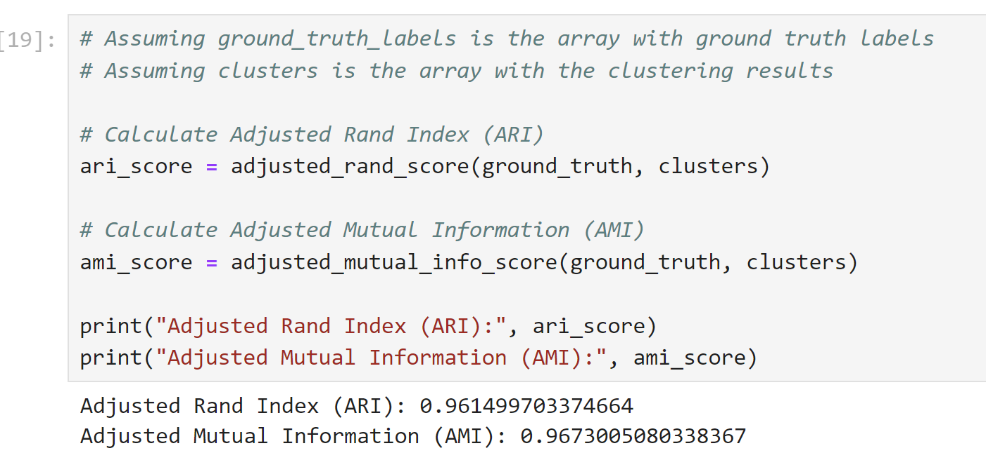
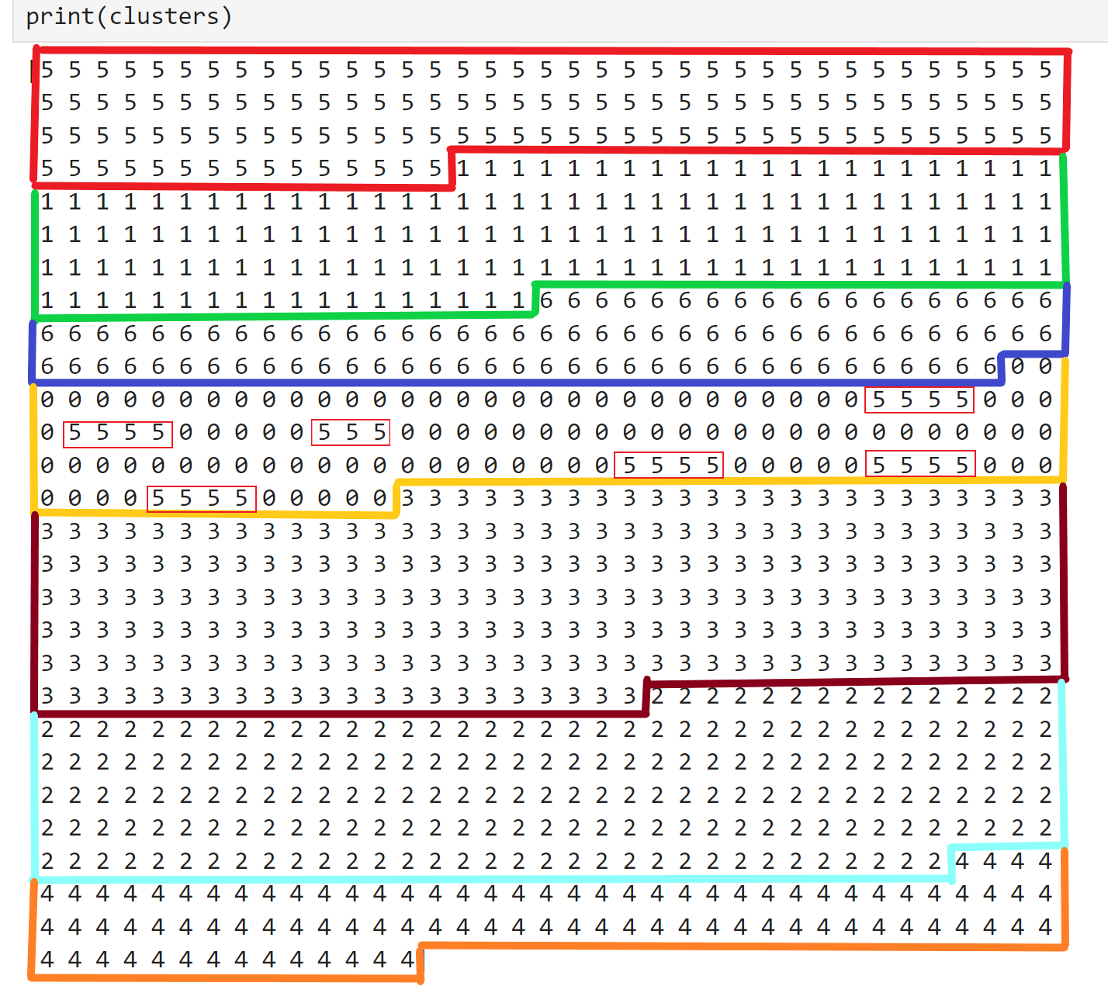
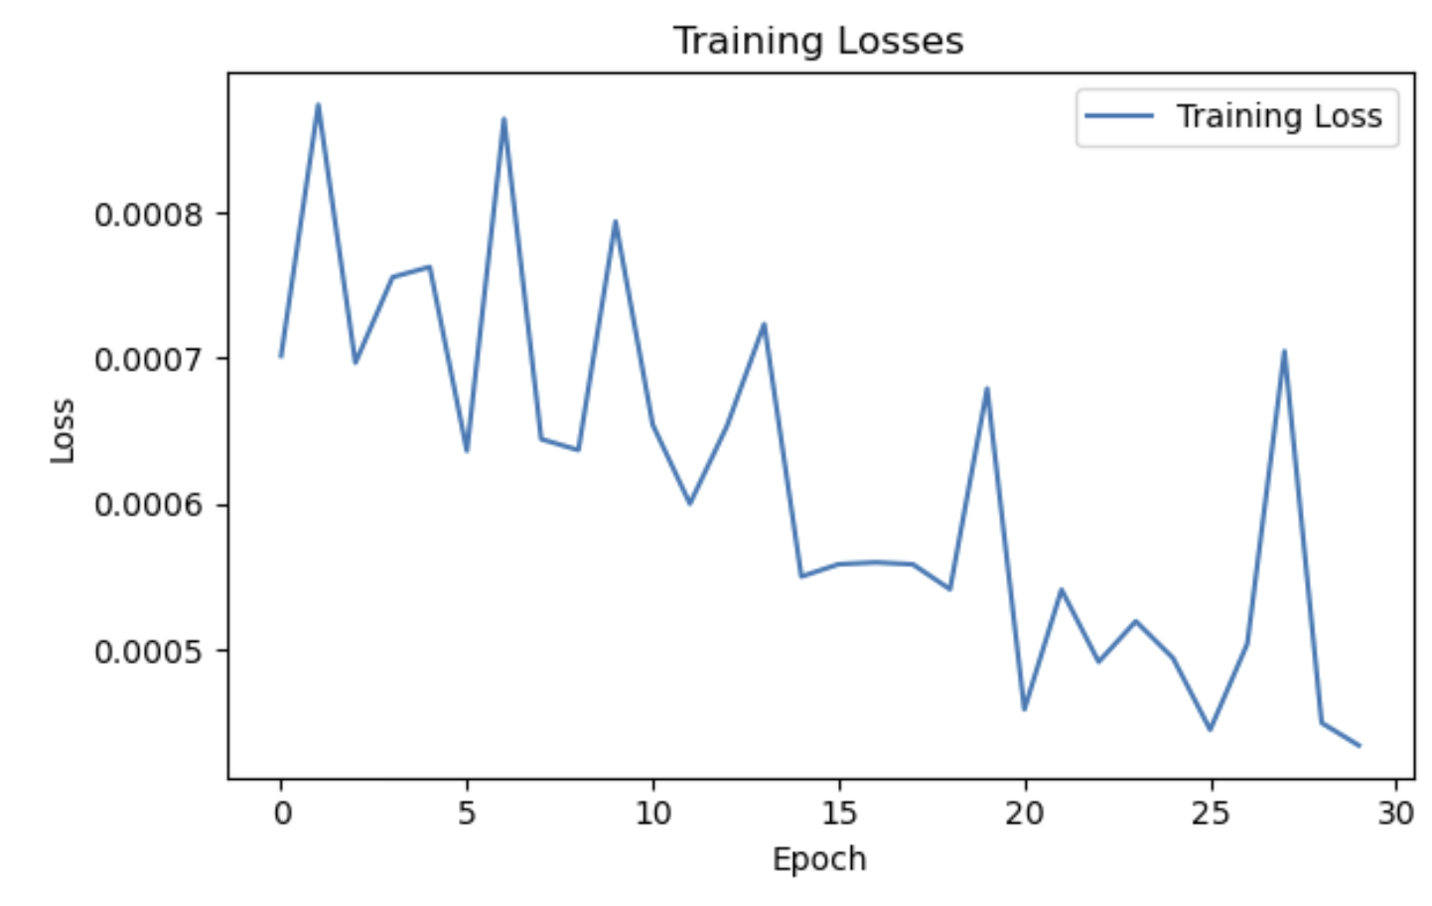
Results
Tested the same data, using ONLY RGB data
Achieved ~0.96 score
Some scenes had mismatches
Notes:
NICK - So we ended up copying our notebook and making some slight modifications so we didn't use the depth information channel, and we ended up achieving around a 0.96 score which is not perfect, but still performs well. You can see the output of the clusters on the right here and if you look in this yellow one, you can see there are a few mis-classifications that mistaken the scenes to be from the red cluster. We also made sure to use the same model architecture with the same number of layers for RGB.

Slide 8
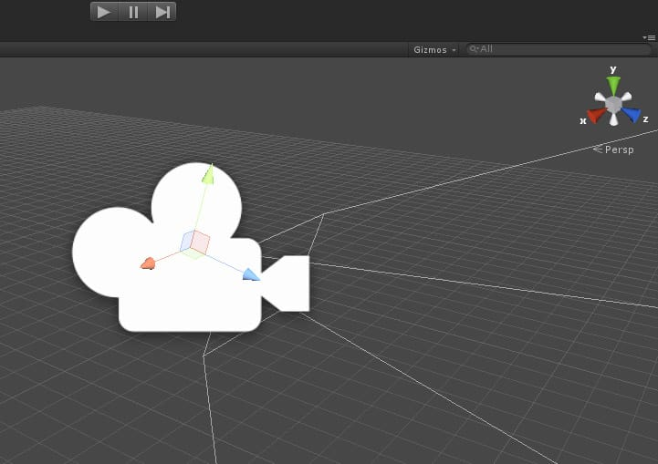
Conclusion
We believe including the depth information was helpful in the clustering of the data
Future work
Include camera data which was provided by the dataset (transformation, rotation, etc)
Look into using 3D convolutions
Pros
Could be very helpful as they are designed to capture the spatial and temporal dimensions of the data
Since the scenes in our data have slight variations from frame-to-frame, a 3D convolution may be able to learn these temporal differences
Cons:
computationally expensive & requires substantial amounts of data
Notes:
NATE - Based on our results from the RGB-D vs RGB clusterings, we believed that the depth information did actually help our clustering since we outperformed it when including the depth. This was a very fun project and in terms of the future, we would think about including the camera data which includes the coordinates and rotation of the camera (but we didn't know if that would kind of be cheating since that information would be very helpful in clustering). Otherwise we also looked into 3D convolutions while doing our project (which was suggested by Professor Jacob) but could not achieve the same results that we got from 2D convolutions. We still think it'd definitely be worth looking into since 3D convolutions can capture spatial and temporal dimensions of data. This would hypothetically be very useful for a dataset like Monkaa (the one we used) since each frame has a difference from the last by slightly changing the transform or rotation of the camera. However it it's also worth noting that it's more computationally expensive and would require a substantial amount of data to learn from (which would not be a problem for our dataset).

Slide 9
Thank you
Members
Nick Hageman – nicholas-hageman@uiowa.edu
Nate Schaefer – nathanschaefer-schaefer@uiowa.edu
Github Repo
https://github.com/Nick-Hageman/RGBD-Unsupervised-Clustering
Citations
Yurong You, Katie Luo, Cheng Perng Phoo "Learning to Detect Mobile Objects from LiDAR Scans Without Labels", 2022 IEEE/CVF Conference on Computer Vision and Pattern Recognition (CVPR), pp.1120-1130, 2022.
uiowa.edu
Notes:
So that was our project, thank you for watching our presentation!

